Slide 1
Taking a screenshot
Notes:
[Mandatory Slide] This would be the introduction slide of the topic that you are covering in this subsection.
When this slide plays, you could talk about the main aim that we’d be covering in this video.

Slide 2
In this Video, we are going to take a look at…
Screenshots
The pyscreenshot library
Code: take a screenshot
Notes:
[Mandatory Slide]
Before the start of the video, we’d like to highlight what are important topics or pointers that we’d be covering in this video. This slide would immediately follow the intro/name slide. This would just be say 2-3 points for the viewers to know what they are getting into.

Slide 3
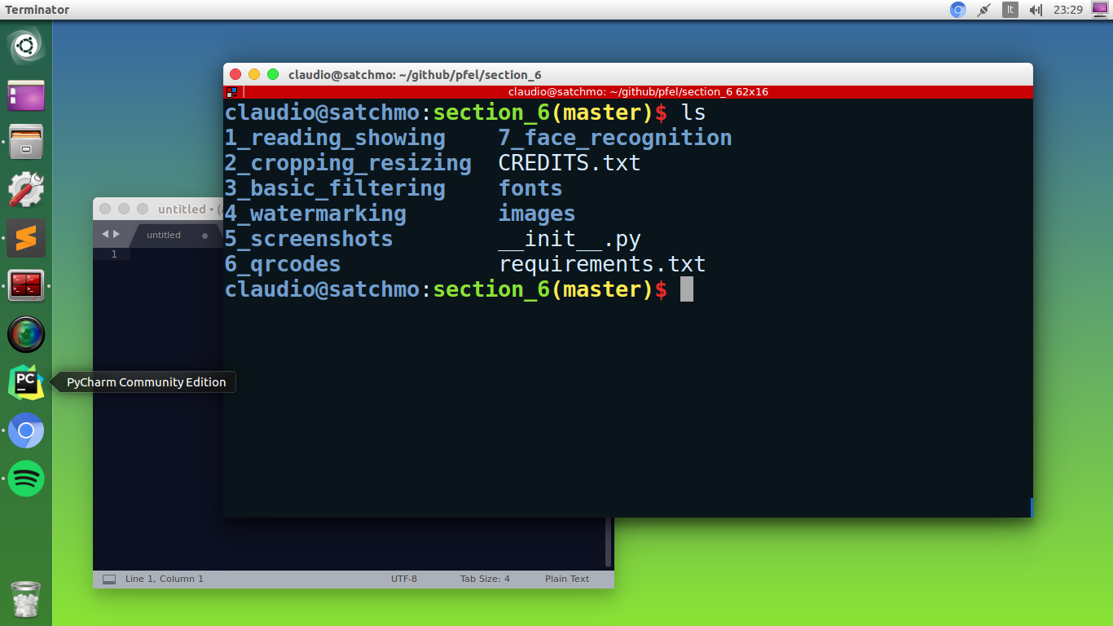

Screenshots
Notes:
[Mandatory Slide]
Before the start of the video, we’d like to highlight what are important topics or pointers that we’d be covering in this video. This slide would immediately follow the intro/name slide. This would just be say 2-3 points for the viewers to know what they are getting into.

Slide 4
The pyscreenshot library
The pyscreenshot library makes taking screenshots a charm
Grab the whole screen
ImageGrab.grab()
Grab a bounding box
ImageGrab.grab(left, upper,
right, bottom)
As usual install with: pip install pyscreenshot
Notes:
[Mandatory Slide]
Before the start of the video, we’d like to highlight what are important topics or pointers that we’d be covering in this video. This slide would immediately follow the intro/name slide. This would just be say 2-3 points for the viewers to know what they are getting into.

Slide 5
Code: take a screenshot
Notes:
Something that needs to grab the viewers attention!!

Slide 6
Summary
Screenshots
The pyscreenshot library
Code: take a screenshot
Notes:
[Mandatory Slide]
Before the start of the video, we’d like to highlight what are important topics or pointers that we’d be covering in this video. This slide would immediately follow the intro/name slide. This would just be say 2-3 points for the viewers to know what they are getting into.

Slide 7
Parsing QR codes
Next Video
Notes:
[Mandatory Slide]
Here the name of the next video needs to be mentioned. The narration as you guessed it would be just letting the viewer know exactly where we are at and what we’d be taking over next! ☺

